Slide 1

Dimensionality Reduction
Using Feature Hashing
MTP SCEE 2019-20
Suryakant Bhardwaj, B16117
Hrushikesh Sudam Sarode, B16032
Under the guidance of
Dr. Rameshwar Pratap

Slide 2
Why Dimensionality Reduction?

Slide 3
Collection of Large Data
Data size beats Computing Power
1
2
3
Vector Representation of Data
4
High Dimensionality of Vectors

Slide 4
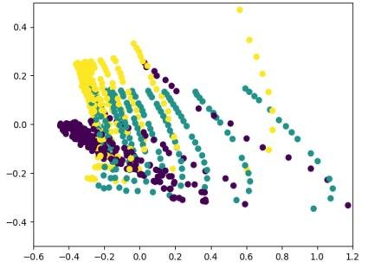
Size of dataset depend on number of data points as well as on dimension of each data point.
We can’t control the number of data points involved for representing a real world entity model.
But size of dataset can be reduced by reducing the dimension under which each data point is represented.
Insert growing data image

Slide 5
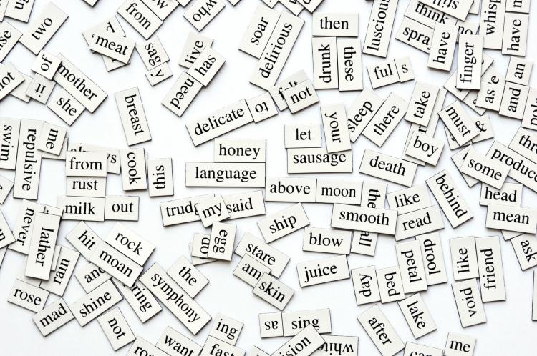
Consider machine learning model which will check the similarity between two given documents.
Requires large dataset for training that model and a dictionary containing list of attributes for which each data point is represented in vector form.
Since dictionary can be too large may be of size 10000 to 100000.
A bag of word Image

Slide 6
Dimension involved with each data point may become very high.
This can be solved if somehow these data points ( documents ) can be represented in vector of much lower dimension.

Slide 7
Our Problem Statement

Slide 8
To achieve dimensionality reduction using feature hashing while preserving the similarity between the data objects.

Slide 9
Our Methodology

Slide 10
Motive
Reduce d dimensional Vector to N dimensions
Where N << d
<a, b> ≅ <a’, b’>
a, b - N dimensional vectors
Where , a’, b’ - N dimensional vectors

Slide 11
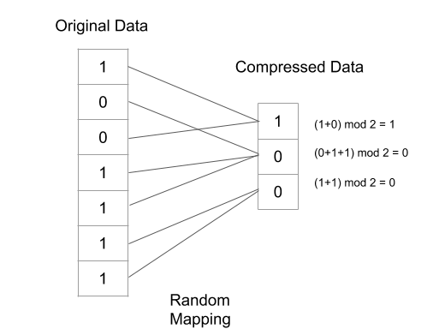
Compression scheme for Binary data
Sparse Data
s - sparse data
N = O(s²)
N
d
N = 3
d = 7

Slide 12
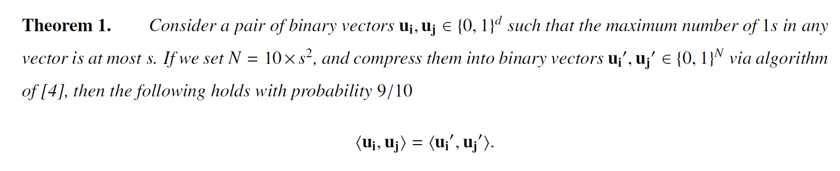
Theorem Used for Binary Data
Source - Efficient Dimensionality Reduction for Sparse Binary Data

Slide 13
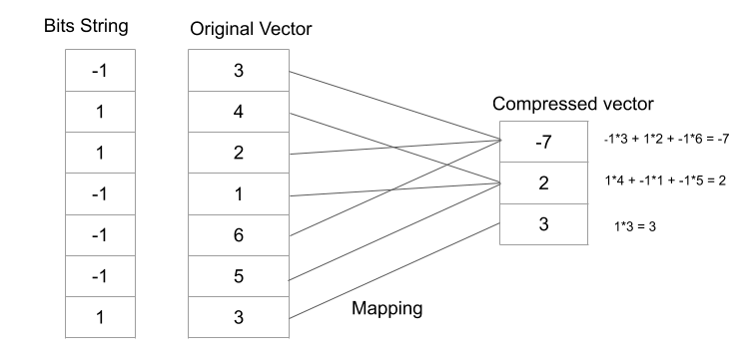
Real Valued Data
Random Mapping
Random Bits
d
N
N = 3
d = 7

Slide 14
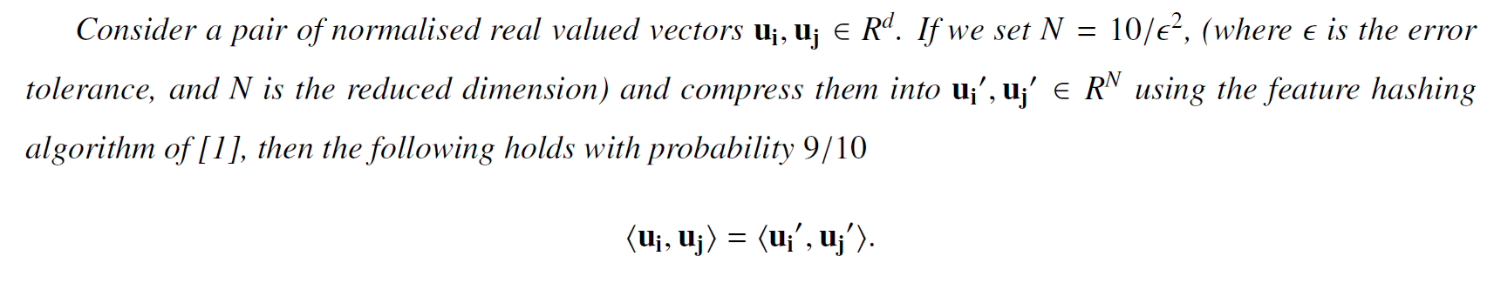
Theorem Used for Real valued data
Source - feature hashing for large scale multitask learning

Slide 15
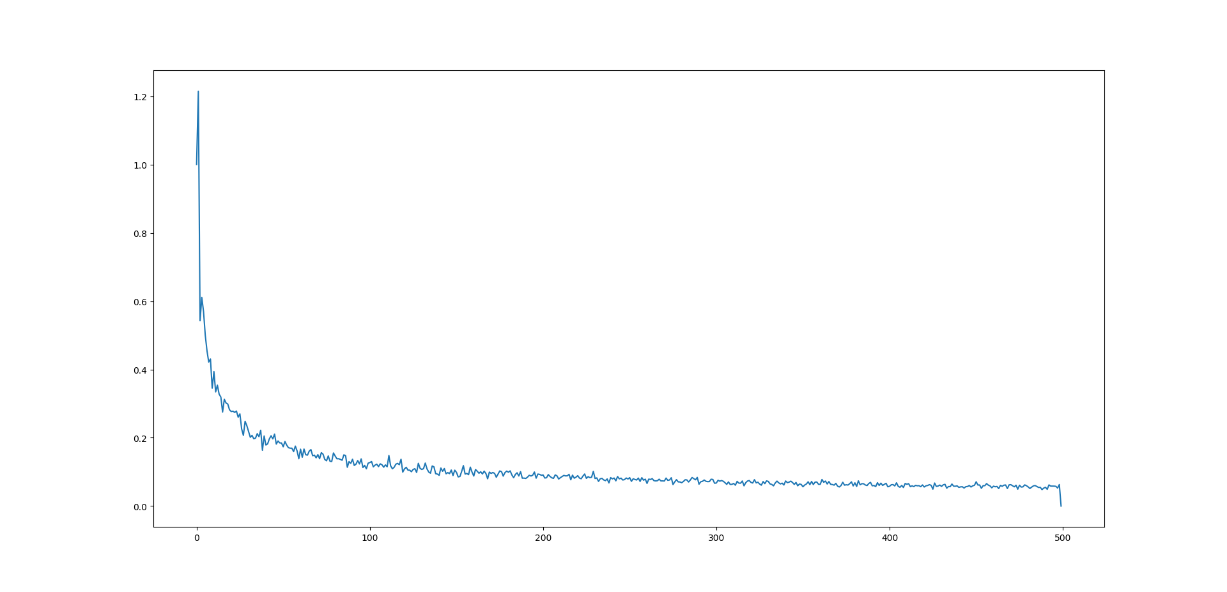
Defining N for Real Valued Data
Trade off between Error and Storage
MSE
Size of N

Slide 16
Why these compression scheme ?
Solves for high dimensional sparse data which is most common form of data now days.
Independent of dimension and depends only on sparsity of data.
Retain similarity between any 2 data points

Slide 17
Our Challenges
-To come up with a data structure(code) which can maintain a random mapping while handling insertions and deletions for features in a growing dataset.

Slide 18
Random Mapping
Used compression scheme demands highly random mapping .
Highly random mapping is must for Uniform mapping of features from high dimension to lower dimension.

Slide 19
Insertion and Deletion Handling
Since dataset can be growing.
New features can be added and deleted.
Our code should be compatible with the proper feature insertion and deletion.
Improper handling of mapping may result in risks of non uniform mapping.

Slide 20
Future Application

Slide 21
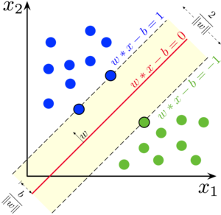
In classifier
Consider a d dimensional dataset for a Binary classification problem.
Let any data point be represented as X.
Let curve learned as a classifier be A as a d dimensional vector.
For classification Inner product of A and X will be involved.

Slide 22

In clustering
Our compression scheme guarantee to maintain similarity between data points.
Clustering Algorithms involves clustering of similar data objects.

Slide 23
Thank You
N
d
N = 3
d = 7

